Slide 1
DataBase Model

Slide 2
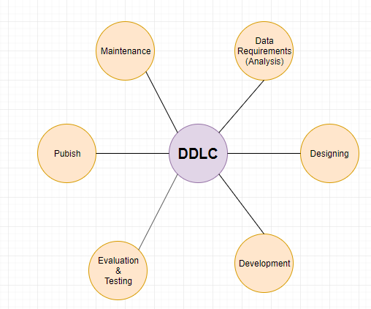
Database Development LifeCycle

Slide 3
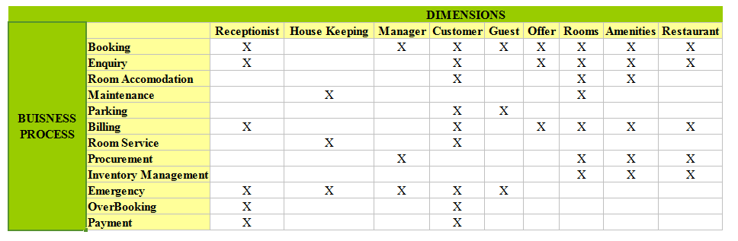
Bus Matrix

Slide 4
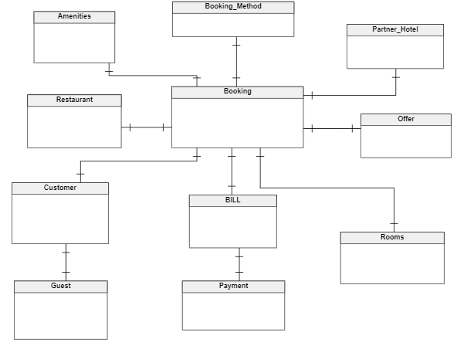
Conceptual Data Model

Slide 5
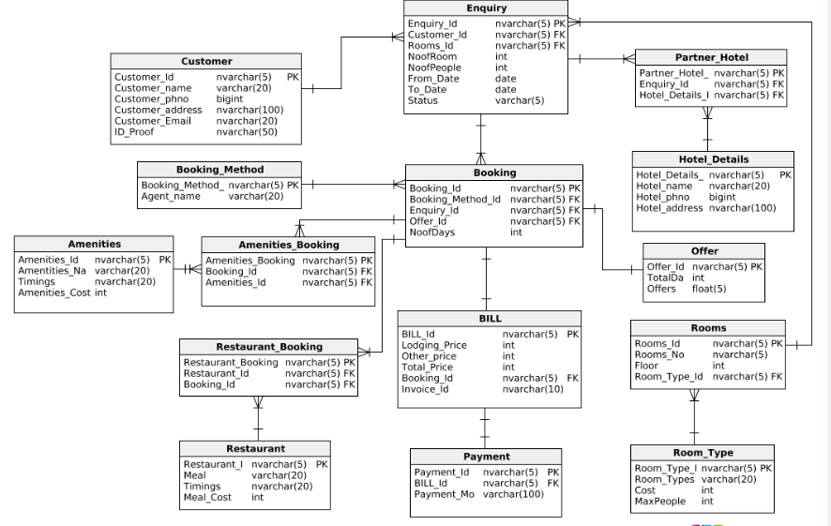
Logical DataModel

Slide 6
Physical DataModel
Populating the data values to each tables in the data model.
Importing script from vertabelo to SSMS.
Querying.

